Slide 1
King Hammurabi and the Code of Hammurabi
Introduction

Slide 2
Introduction
Ancient kings ruled with their people with heavy hands
They acted ruthlessly to their subjects
However, one king, Hammurabi ruled his people in a fair way.
The kingdom of Babylonia, about four millennia ago, prospered and thrived under his regime.
King Hammurabi’s ambition was to protect the weak and the vulnerable in his kingdom, and by so doing he taught his people how to exercise justice and righteousness.
The king’s success comes from the implementation of the code of Hammurabi inscribes on a stone pillar, known as stele

Slide 3
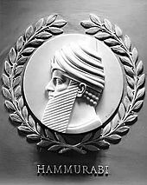
Image of king Hammurabi
Notes:
The kingdom of Babylonia, about four millennia ago, prospered and thrived under his regime.

Slide 4
Biography of King Hammurabi
King Hammurabi ruled the Babylonia kingdom for thirty years (1894- 1595 B.C).
The king’s family was a member of the Amorites which is a semi-nomadic tribe found in the western part of Syria.
the king’s name suggests that he valued the diversity of cultures. For instance, the word “Hammu” refers to “family” in the Amorite language
when Hammurabi was in his thirtieth year on the throne, he started expanding the Babylonia kingdom along the valley of river Tigris and Euphrates.
he conquered empires like, Assyria, Larsa and Mari for they stood his way
the king used his military and political skills and irrigation project to manage his thousand subjects.

Slide 5
A Brief Description of the Hammurabi Code
The regime of King Hammurabi inscribed the Hammurabi’s code on a heavy slab of diorite.
The top side of the stele contains the carving of Babylonian god of justice, Shamash, handing over the law to Hammurabi.
The code of Hammurabi is a set of laws of retribution, which people refer to as “an eye for an eye” doctrine.
Although the code of Hammurabi involved severe punishment it stated that a person was innocent until proven guilty.
The law, however, touch ethical codes from the family level to professional and administrative law and describes the kind of justice rendered to the three distinctive classes of people in Babylonia, i.e., propertied, freedmen and slaves.

Slide 6
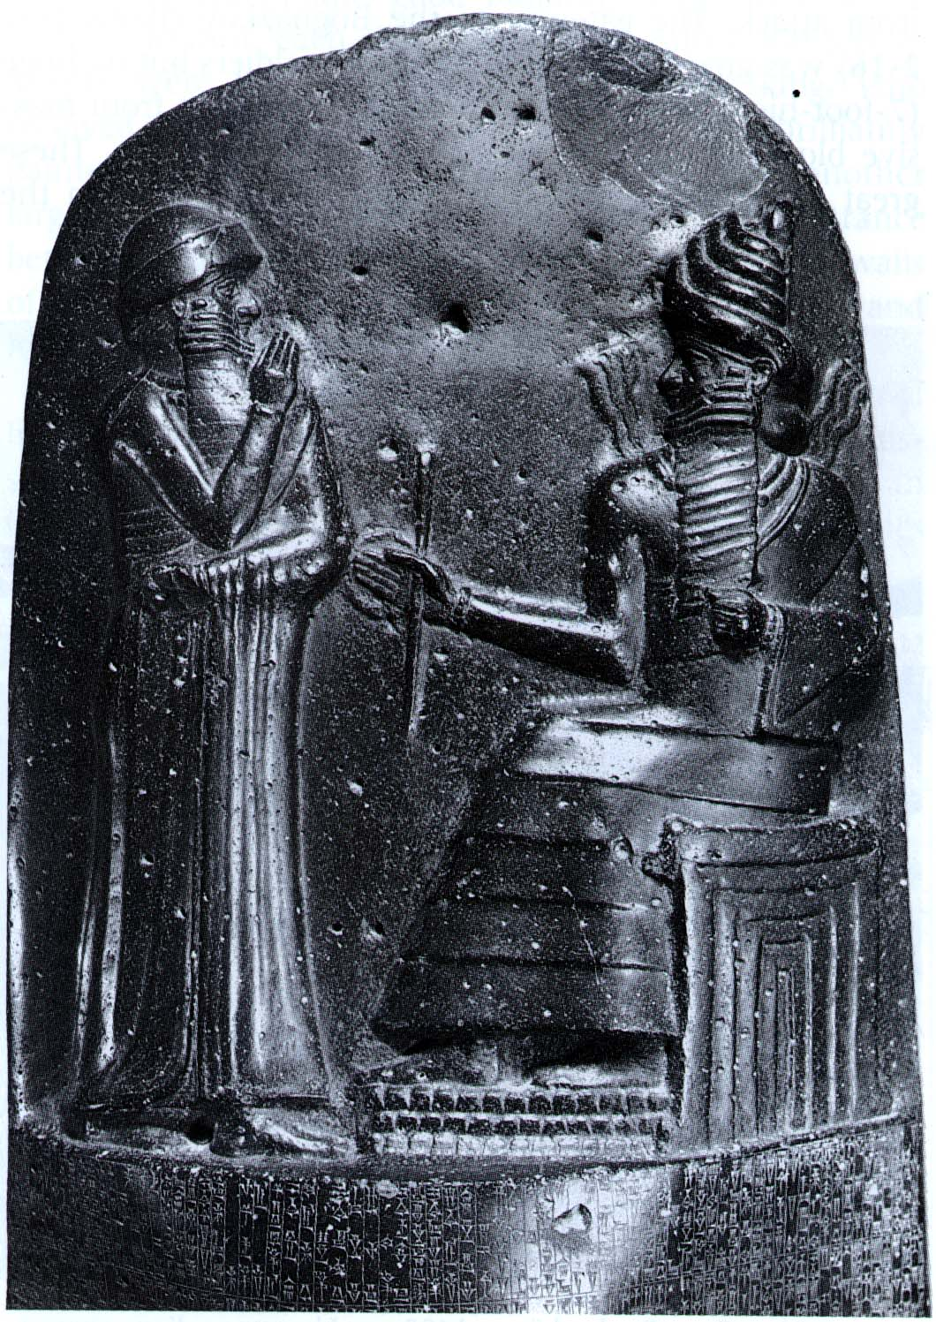
Photo Of The Hammurabi Stele
Notes:
The top side of the stele contains the carving of Babylonian god of justice, Shamash, handing over the law to Hammurabi. The inscriptions are on the lower part of the stone.

Slide 7
The influence Hammurabi and his Code to the lives of Babylonians
The Babylonian king served and provided for the people of Babylonia.
During that period many people referred to him as the “Bani matim” which means: the builder of the land.”
Hammurabi’s efforts amounted to one objective: to better the lives of his subject.
The Babylonians lived in decent houses, and the entire kingdom looked magnificent due to the work of skilled engineers and architectures.
The codes improved morality in the Babylonian community.
For instance, when a person accuses a woman of committing adultery with other woman’s husband, the woman accused swims across a divine river. If she survives the ordeal, people say that she is innocent and the accuser is guilty of false accusation which is punishable by death.

Slide 8
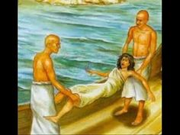
A Photo of an Accused Woman, about to be Thrown in a Divine River
Notes:
If she survives the ordeal, people say that she is innocent and the accuser is guilty of false accusation which is punishable by death.

Slide 9
The fall of The Kingdom of Babylonia
When Hammurabi died in 1749 BCE, his son tried to fight the invading enemies while preaching unity to all the regions under the umbrella of Babylon.
Since king Samsu- Iluna was young and less experienced his efforts of mobilizing his people to unite and fight back the enemy failed.
The Hittites invade in 1595 BCE followed by the Kassites.
The successful invasions destroyed the uniting bond between the regions of Babylonia.
Therefore, cities under Babylon city put demarcations and declared their autonomy.
The kingdom stumbled making it hard for Hammurabi’s successors to bring back

